Slide 1
Managing LIBOR transition
New risk-free rates in Refinitiv Eikon
January 2022

Slide 2
The LIBOR transition
The financial services industry is migrating away from LIBOR benchmarks towards the new risk-free rates (RFRs)
As a result of the transition to RFRs, new conventions are emerging in the markets as new transactions can no longer link to Libor and legacy contracts must include fallback language.
The new year signaled the end of most LIBOR rates, creating a solution of continuity to a process which lasted for decades. The majority of LIBOR settings ceased by end-2021, while overnight, one, three, six and 12-month US dollar LIBOR will continue until end-June 2023 to support the rundown of legacy contracts only. On September 29, 2021, the FCA announced plans to continue publishing one, three and six-month sterling and yen LIBOR rates in synthetic form from January 4, 2022.
In recent years, regulators and central banks have announced and released a series of overnight RFRs such as Sterling Over Night Index Average (SONIA) in the UK, Secured Overnight Financing Rate (SOFR) in the U.S. and Euro Short-Term Rate (€STR) in the Euro area, as well as Swiss average rate overnight (Saron) for the Swiss franc and Tokyo overnight average rate (Tonar) for Japanese yen.
While much of the market is expected to adopt these overnight RFRs, administered by central banks, demand remains for term rate benchmarks based on RFRs for loans and other cash products. Fallbacks for cash products and derivatives, as well as enhancements to swap rates, are also key components of a smooth transition.
Refinitiv is committed to providing the data and benchmarks clients need to adjust operating models across front, middle and back offices and to create new financial products in light of the IBOR reforms and LIBOR transition, while also ensuring we meet the high regulatory standards required for benchmarks.

Slide 3
IBOR reform
Refinitiv key initiatives - Content and analytics
Market Data
Broker Data
Reference Data
Derived Data
ARR fixings incl. GBP, JPY Synthetic Libors and Time Series
Term rates, compound indices
Data availability across full suite of Refinitiv services
Access to Brokers Data: Tradition, FENICS, ICAP, Tradeweb, Tullet Prebon
ARR Derivatives data: OIS, Basis Swaps, Cross Currency Swaps, Cap / Floor Vols and Swaptions
New fields to easily identify LIBOR linked securities
Fallback language and triggers captured in bond notes
Zero Coupon basis free curves using RFRs
Bootstrapped OIS curves for discounting/projecting cashflows
Benchmark
Fallback
Search and Monitor
Calculators
Refinitiv Term SONIA
TSR Tokyo Swap Rates
Open to cover other Term Structures ( e.g. €STR)
Refinitiv USD IBOR Cash Fallback rates – ARRC recommended
Refinitiv is ISDA authorised distributor for FB rates
IBOR App as gateway to all relevant data, news, resources and content
Search capabilities updated to detect RFRs underlyings for FRNs and OTC Derivs in SRCH App
FRN New Issues in FINIM
Updated Bond Calc to price FRNs on aRFRs
Updated Swap Pricer
Compound RFR Calculator
New Curve Builder calculator

Slide 4
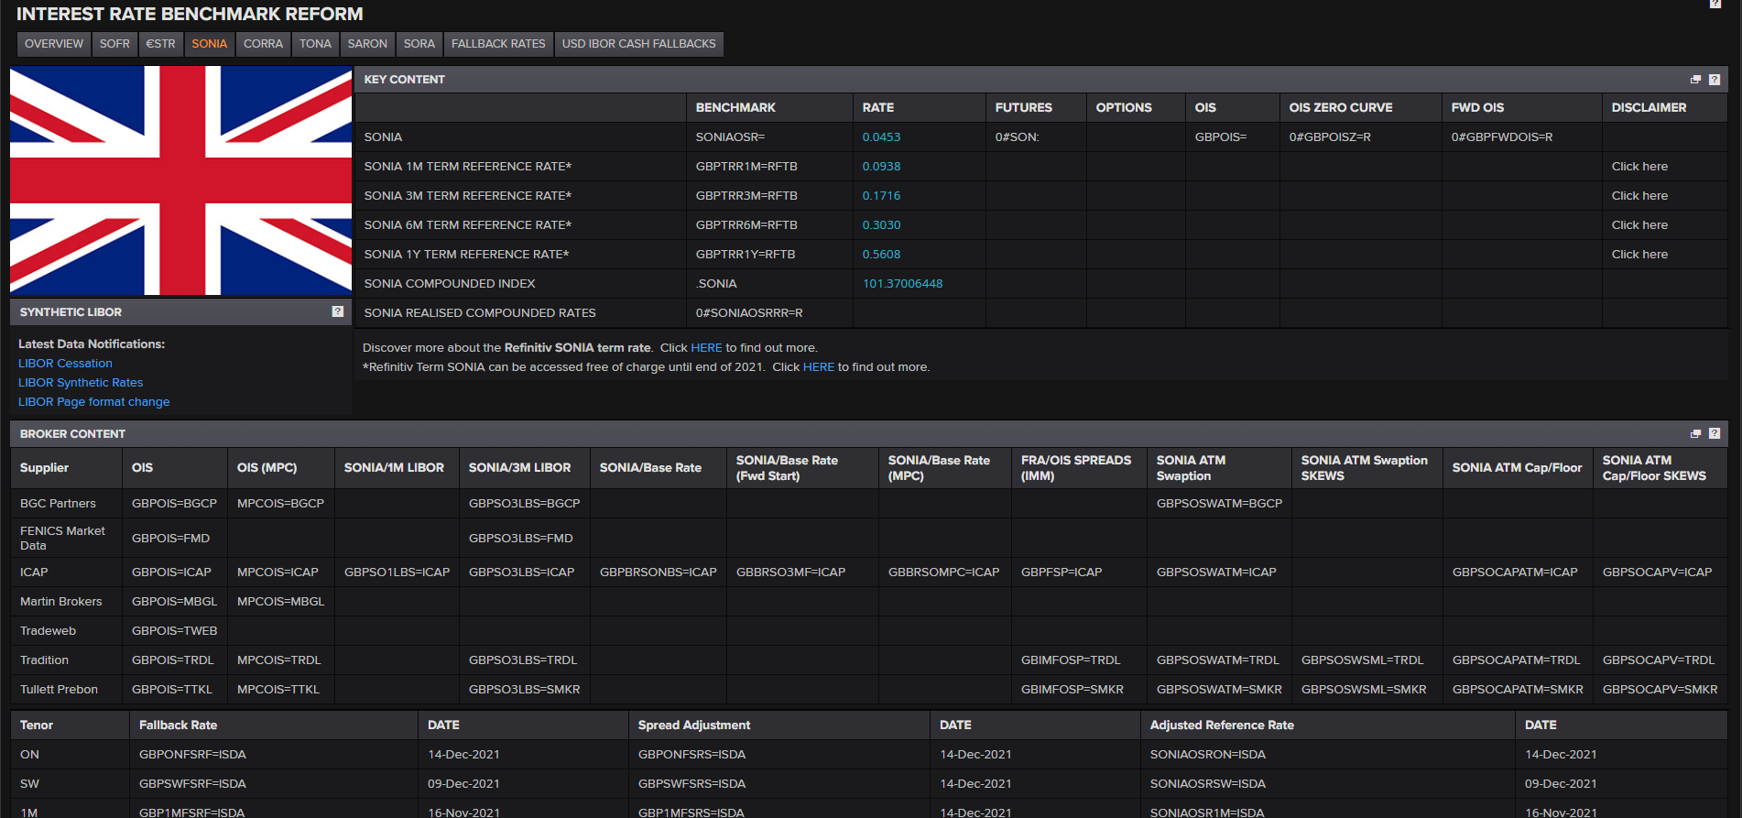
IBOR transition Eikon App
Access all new RFR data, news and analytics on the IBOR page in Refinitiv Eikon®
The IBOR Transition app keeps you up to date with global changes to interest rate benchmarks. The app provides news and values on a variety of rates:
Risk-free reference rates (RFRs)
ISDA Fallbacks,
Brokers RFR derivative content (Fixing, OIS, Basis Swaps, FRAs, CBS, Caps Vols…)
Derived Analytics data: Term Rates, Compounded Rates, Zero Curves
4
An LSEG Business

Slide 5
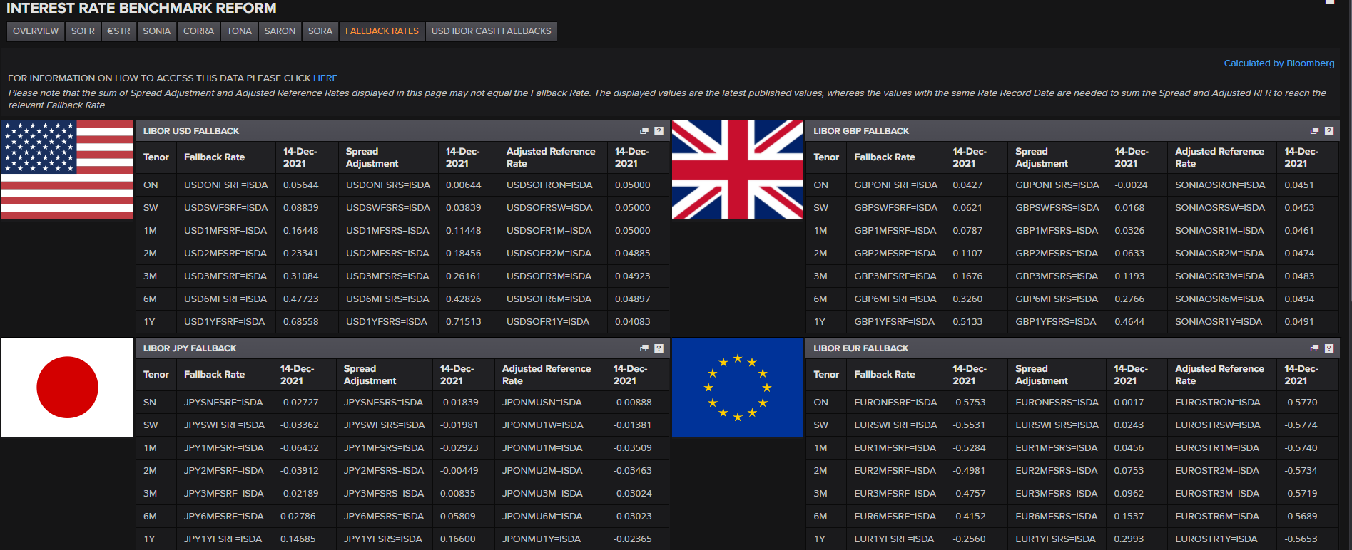
ISDA fallbacks – Refinitiv is an official Authorized Redistributor
Type “IBOR” to open the IBOR App, and select the Fallbacks tab
ISDA fallback rates
Benchmark fallbacks are replacement rates that would apply to derivatives trades referencing a particular benchmark (LIBOR). Source: ISDA
Active conversion & robust fallbacks
Complete active conversion of cash
products. Where active conversion is not possible for loans, ensure robust fallbacks are adopted
Source: Bank of England
5 March 2021 – FCA announcement
FCA announcement on future cessation and loss of representativeness of the LIBOR benchmarks. Consequently, fallback spread adjustment published is fixed as of the date of the announcement for all euro, sterling, Swiss franc, US dollar and yen LIBOR settings. Source: ISDA
5
An LSEG Business

Slide 6
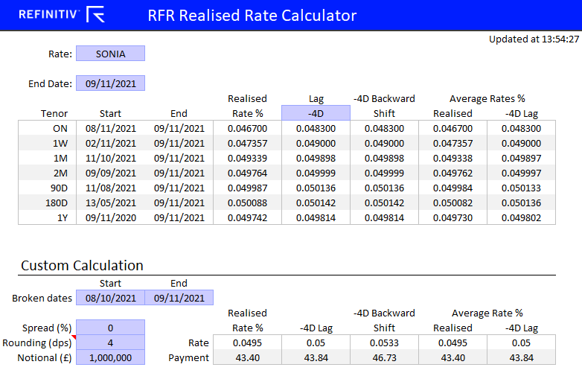
Compounded realised rates
Open the IBOR App to download the Eikon for Excel spreadsheet from the Overview page
Calculate compounded realised rates for key RFR benchmarks for standard tenors (ON, 1W, 1M, 3M, 6M, 1Y) and broken dates.
The lag values are calculated using both the "lookback" and "backward shift"

Slide 7
IBOR reform – Refinitiv benchmarks
Term SONIA
Tokyo swap rates
USD IBOR cash fallbacks
The Refinitiv Term SONIA leverages our extensive experience in administering benchmarks to create a GBP forward looking term risk-free rate, published prior to noon on a daily basis
The Refinitiv Term SONIA benchmark is a forward-looking, risk-free reference rate available in 1-month, 3-month, 6-month and 12-month tenors denominated in sterling and designed to be an alternative to LIBOR
The underlying input data is sourced from a variety of providers and processed under a waterfall methodology, allowing Refinitiv to publish the rate in even the most challenging market conditions
Refinitiv Term SONIA is a readily available data benchmark subject to the UK Benchmark Regulation
Tokyo Swap Rate (TSR) is a Japanese yen (JPY) interest rate swap (IRS) benchmark family that measure the fixed leg of a swap and comprises of two types of benchmarks
JPY LIBOR (six-month) swaps with tenors from 1-year to 40-years
TIBOR (six-month) swaps with tenors
Refinitiv to introduce two new versions of the Tokyo Swap Rate
TONA version - designed to support new market conventions
JPY LIBOR TSR fallback version
Tokyo Swap Rate (for swaps referencing TONA) is a production benchmark administered by Refinitiv Benchmark Services (UK) Limited (RBSL) in compliance with the UK Benchmark Regulation and can be used in financial contracts
The ARRC have issued recommended fallback language specifying the preferred rate(s) that should be used
The ARRC’s recommended fallback language is implemented through the Refinitiv USD IBOR Cash Fallbacks
Refinitiv are the sole benchmark administrator selected by the ARRC to produce these rates
Refinitiv USD IBOR Institutional Cash Fallbacks are production benchmarks for use in financial and non-financial corporate contracts

Slide 8
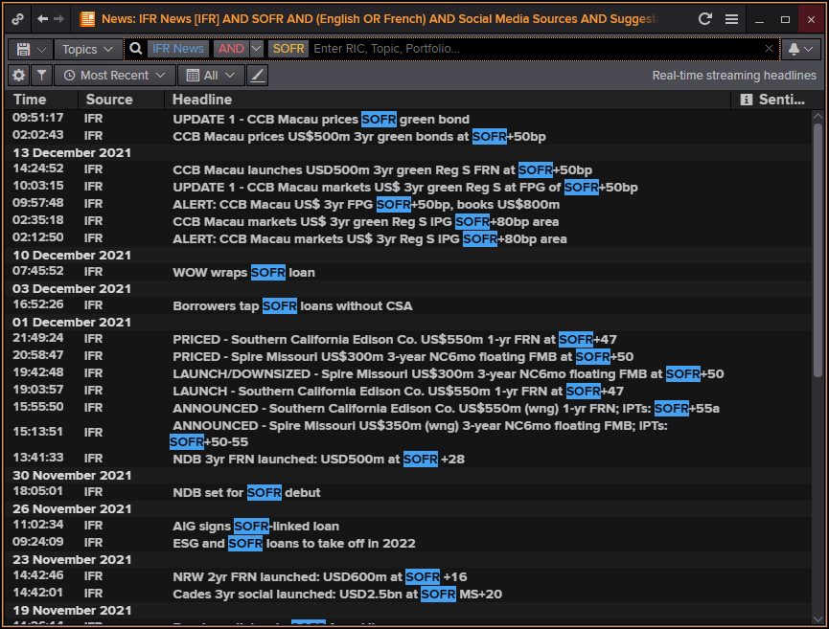
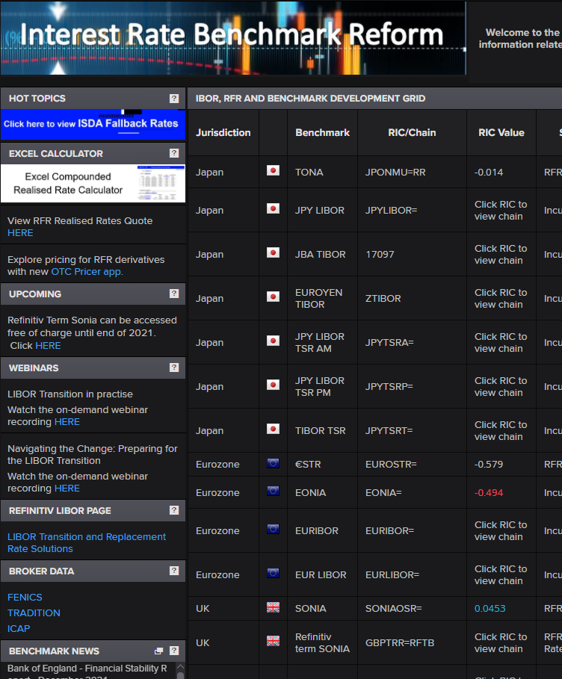
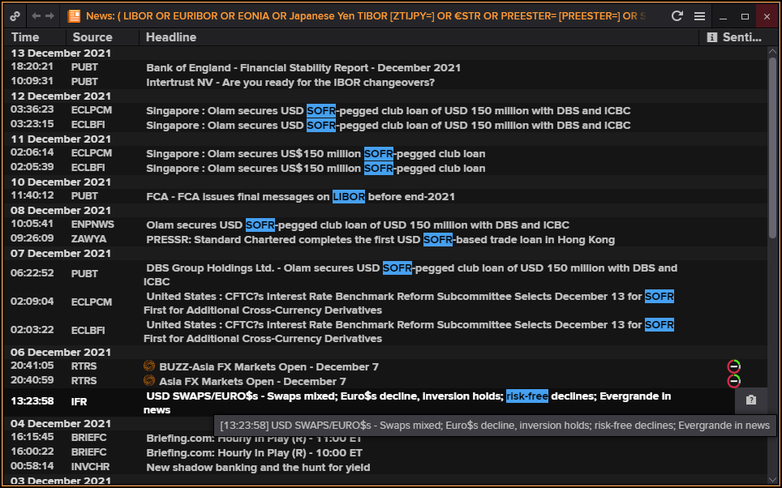
Exclusive LIBOR transition news
Browse Reuters News and IFR to find the latest information on LIBOR transition and new RFRs
Click Pop Up from the Ibor App to see the News, set up an Alert, save it to your Workspace...
To find articles and analysis from IFR, enter IFR AND “SOFR”
International Financing Review (IFR) Leading FI, capital markets, investment banking news and commentary
8
An LSEG Business

Slide 9
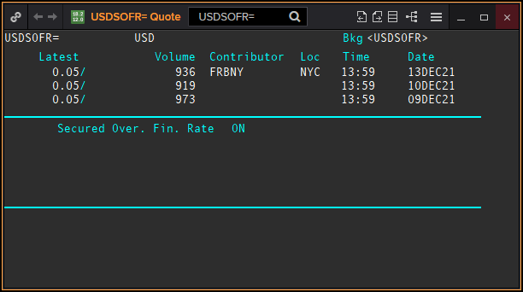
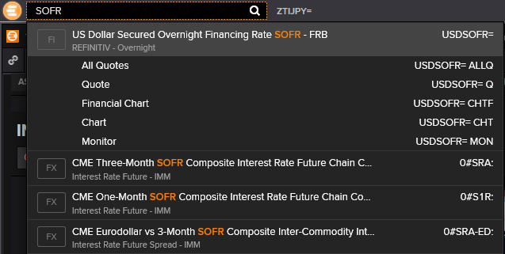
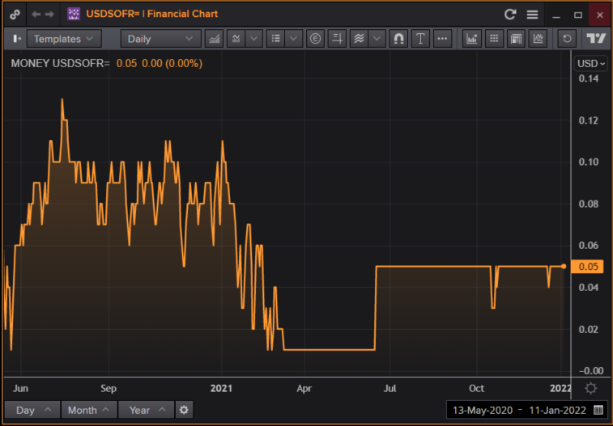
Find new RFRs using the Eikon Search bar
Enter “SOFR”, “ESTR”, “SONIA”… in the Eikon Search bar to find the quotes or load a chart
Other search expressions include “SOFR basis swaps”, “SOFR curve”, “SOFR spreads” and more.
Compound indices are available for SONIA and SOFR, they accrue interest as total return indices
GBP SONIA compound index: <.RFTSONIATR> – to be opened in a Quote
USD SOFR compound index: <.RFTSOFRTR>
Realised rates are the realized return for each RFR over defined rolling periods including 1M, 3M and 6M, and are expressed as percentages on an annualised basis.
9
An LSEG Business

Slide 10
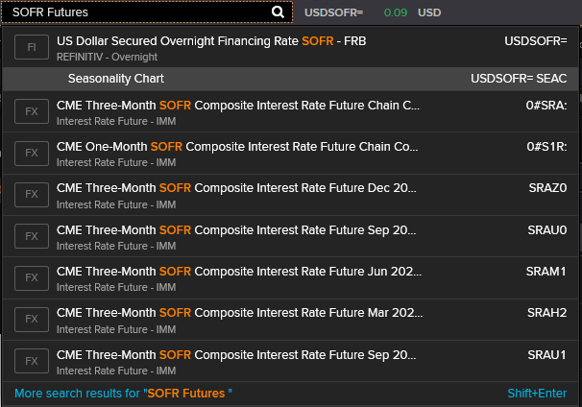
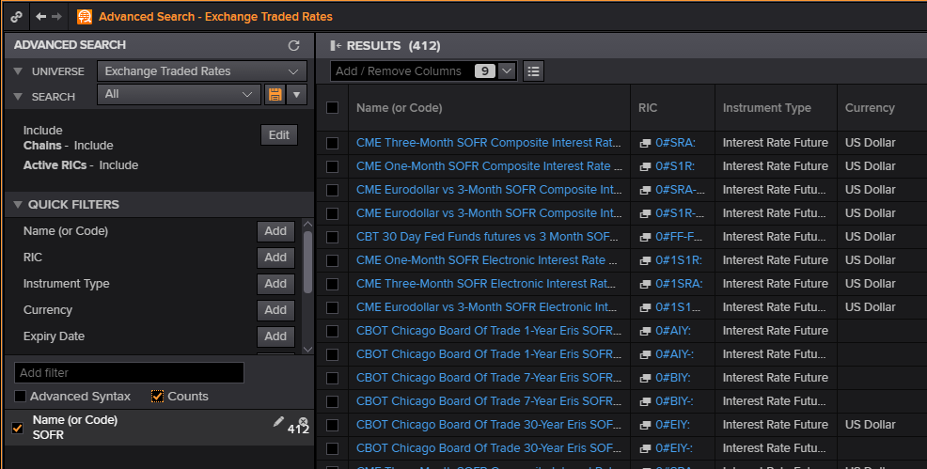
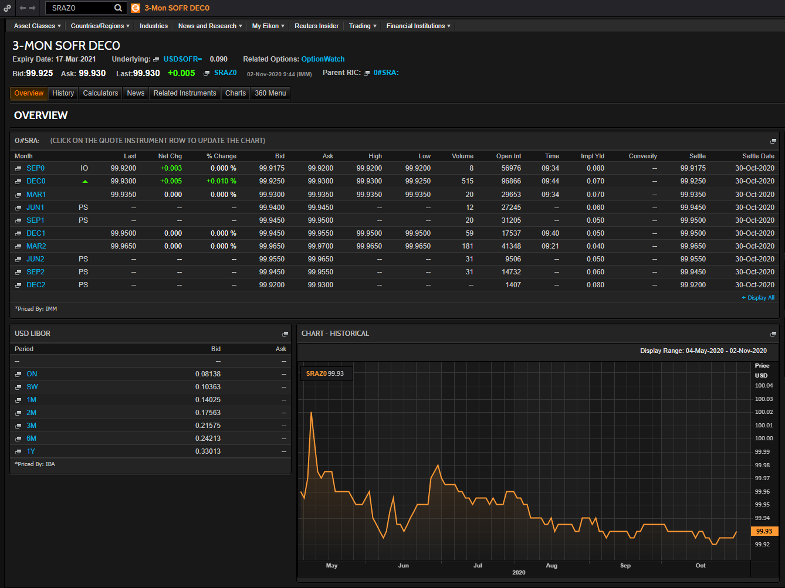
Find STIR Future on new RFRs – SOFR Sample
Enter “SOFR future” in the Eikon Search bar – to find SOFR Stir FUTURES from CME – or use BNDFOSRCH
Alternatively, use the advanced search tool for Exchange Traded Rates, type “BNDFOSRCH” and filter by name containing “SOFR”
10
An LSEG Business

Slide 11
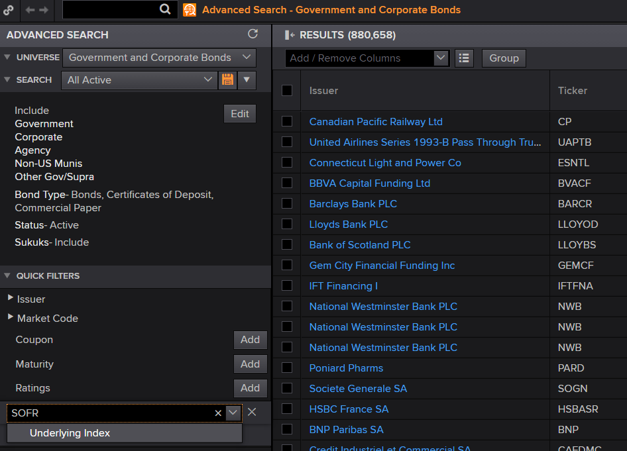
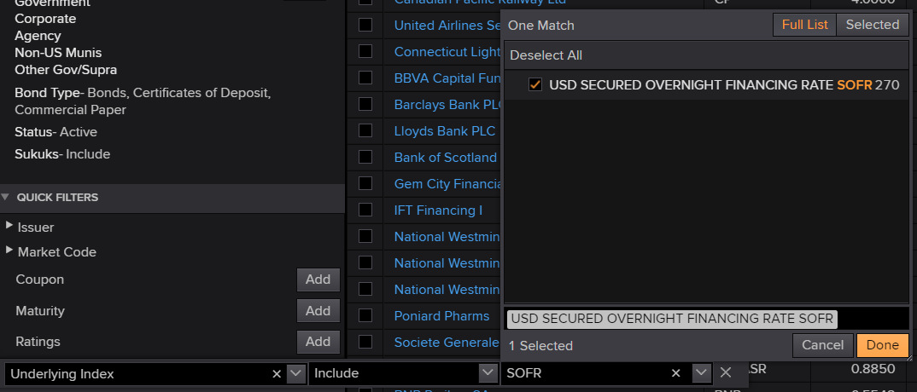
Find new RFR denominated Bonds – SOFR example
Type “GOVSRCH” to open the Eikon bond search tool
Related Refinitiv Eikon Apps:
Use bond calculators’ value to determine coupon calculations for RFR FRNs, select a bond and type “BNDC”
Type “SOFR” in quick filters and click Underlying Index
Filter by Bond Type to display bonds only or certificates of deposits
11
An LSEG Business

Slide 12
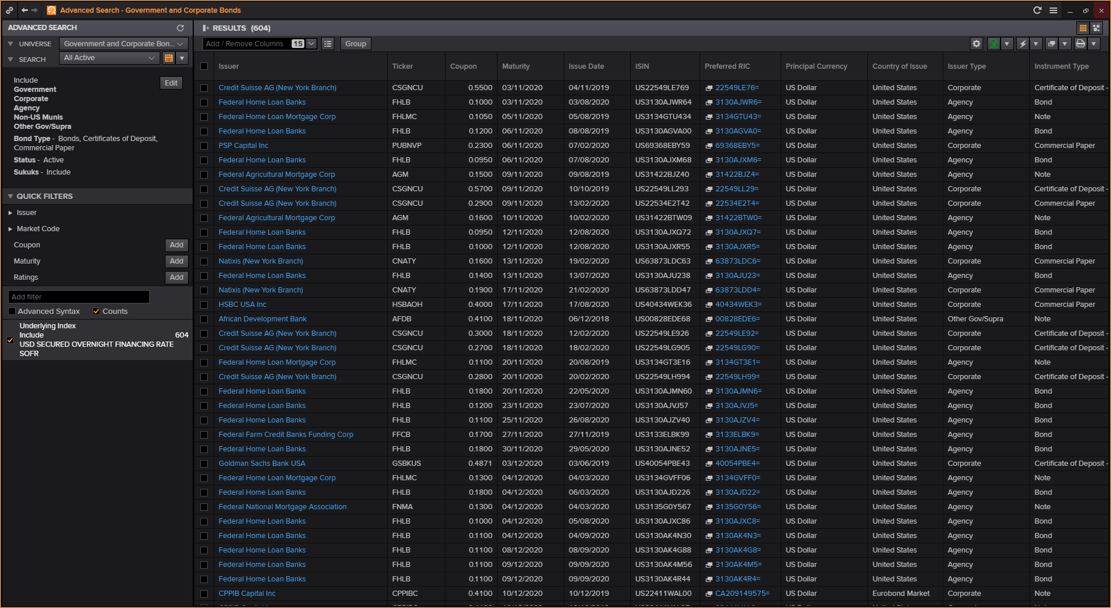
Find new RFR denominated bonds SOFR search results
Save your search filters to re-run the search in one click
Export to Excel® , open the list in Monitor, add/remove columns to customize your display
Click Counts to display the number of Bonds
12
An LSEG Business

Slide 13
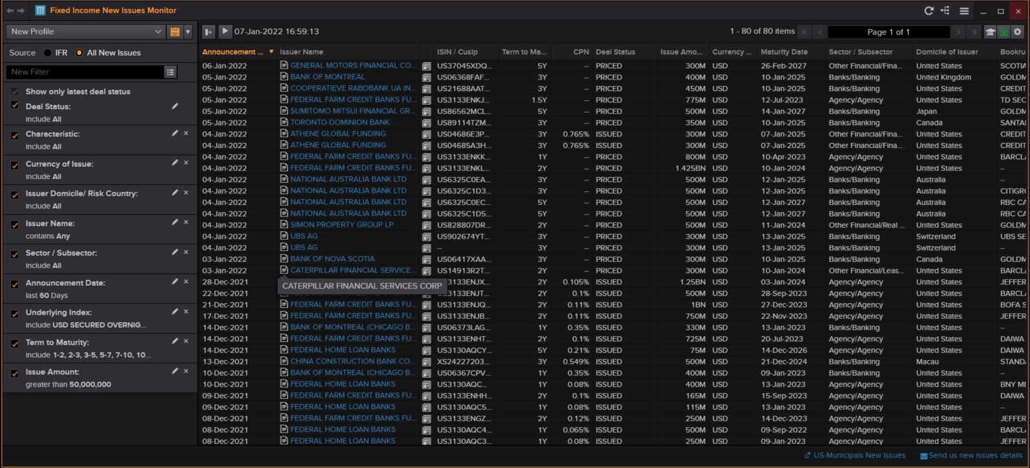
Find new Bond issued on new RFRs – SOFR example
Type “FINIM” to open the Fixed Income new Issues App
Choose All new Issues
Type “index” in the quick filter, choose Underlying Index and enter “SOFR”
13
An LSEG Business

Slide 14
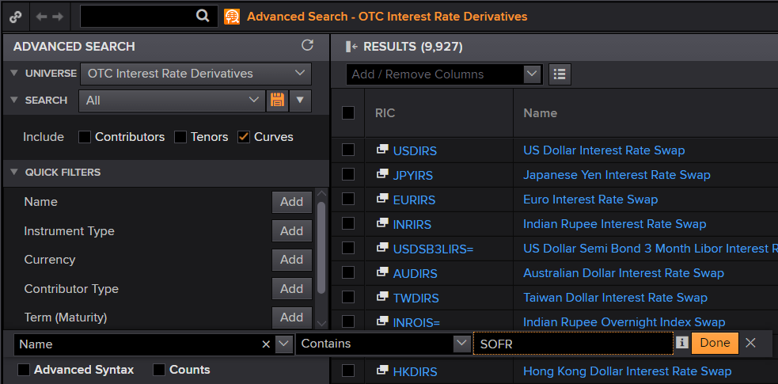
Find new RFR Derivatives – SOFR example
Type “IRDOTCSRCH” to open the Eikon Rates Derivatives advanced search tool
Select Name Contains SOFR
14
An LSEG Business

Slide 15
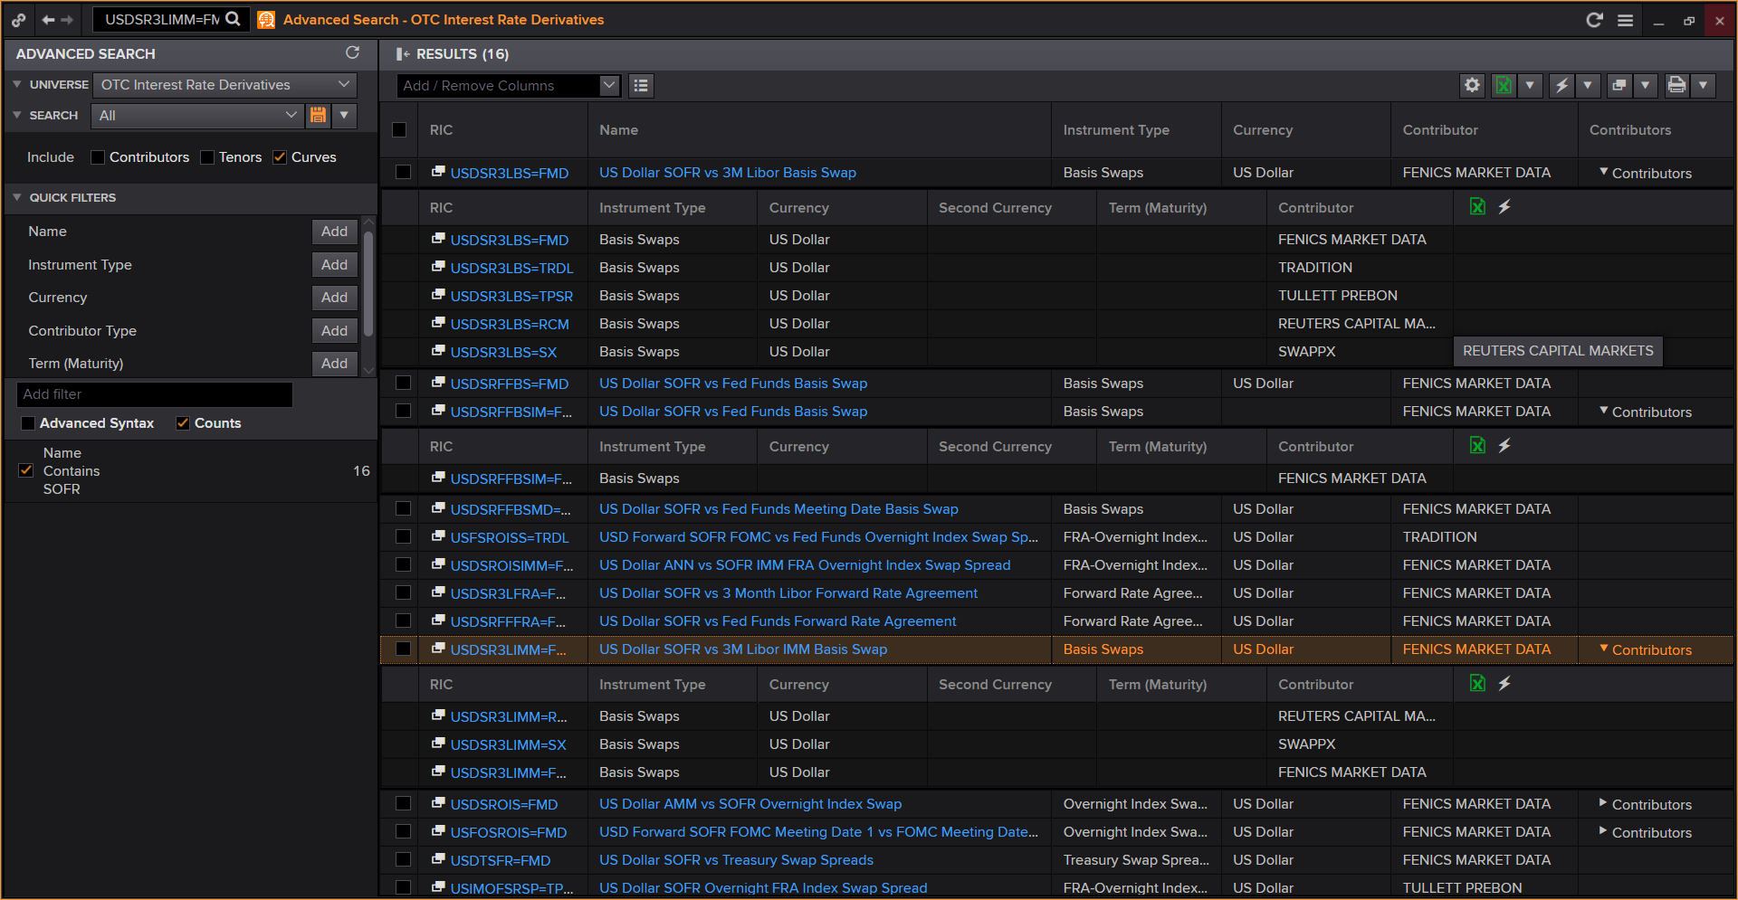
Find new RFR Derivatives – SOFR search results
Save your search filters to re-run the search on one click
Expand Contributors to view Data from Inter Dealer Brokers
Click the Pop Up Icon to open a Quote
Here you will find FRAs, Libor/new RFRs Basis Swaps, Cross Currency Swaps, OIS, Swaptions, Cap Floors
15
An LSEG Business

Slide 16
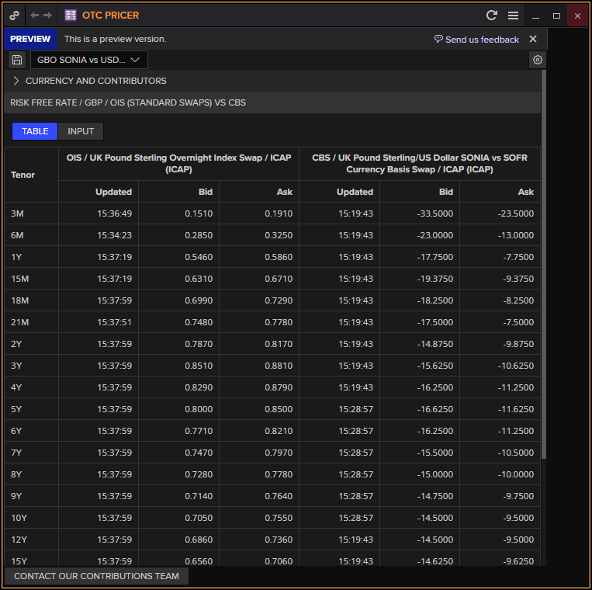
OTC Pricer App
Access existing IBOR rates and RFRs, as well as the crucial basis and new cross-currency basis swaps.
You can easily adjust spreads and combine critical OTC instruments to build views of live market pricing, replacing the need for spreadsheets.
There are up to 20 user profiles that can be saved to allow the user to quickly switch between currencies, contributors, spreads and tenors.
Once you have found the necessary approximate or exact pricing, confirm face values and values using our Swap Pricer (SWPR), and then save trades for future revaluations in MARVAL.
16
An LSEG Business

Slide 17
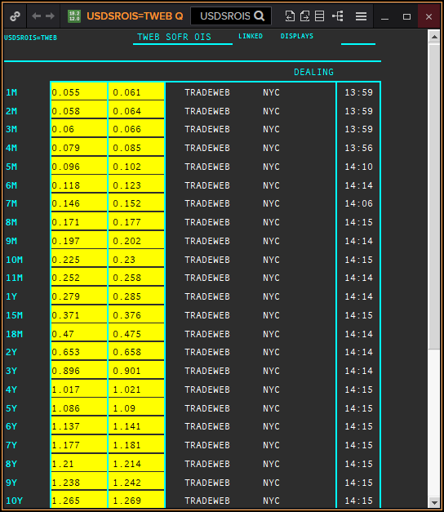
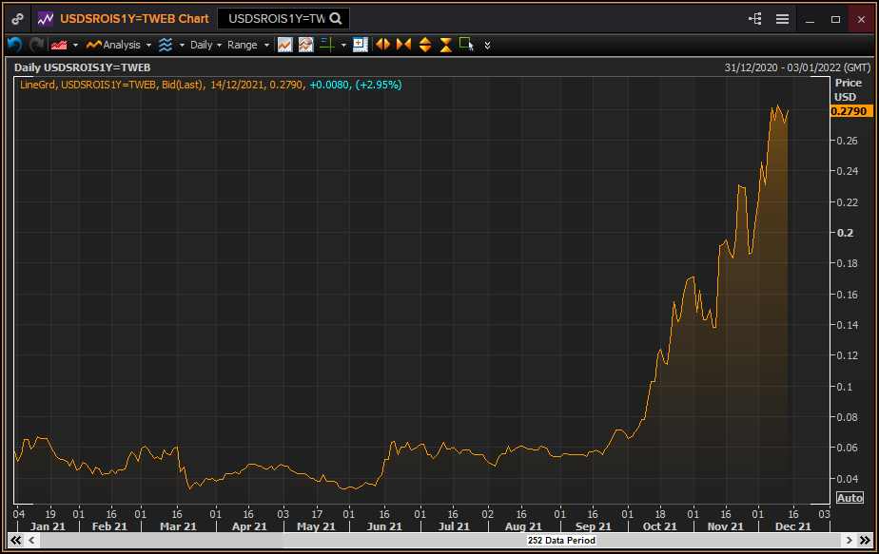
Find new RFR derivatives – Quote display (OIS SOFR from TRADEWEB)
From a Quote, right-click on a Tenor (1Y, for instance) and select Related/Chart to graph the historical value
17
An LSEG Business

Slide 18
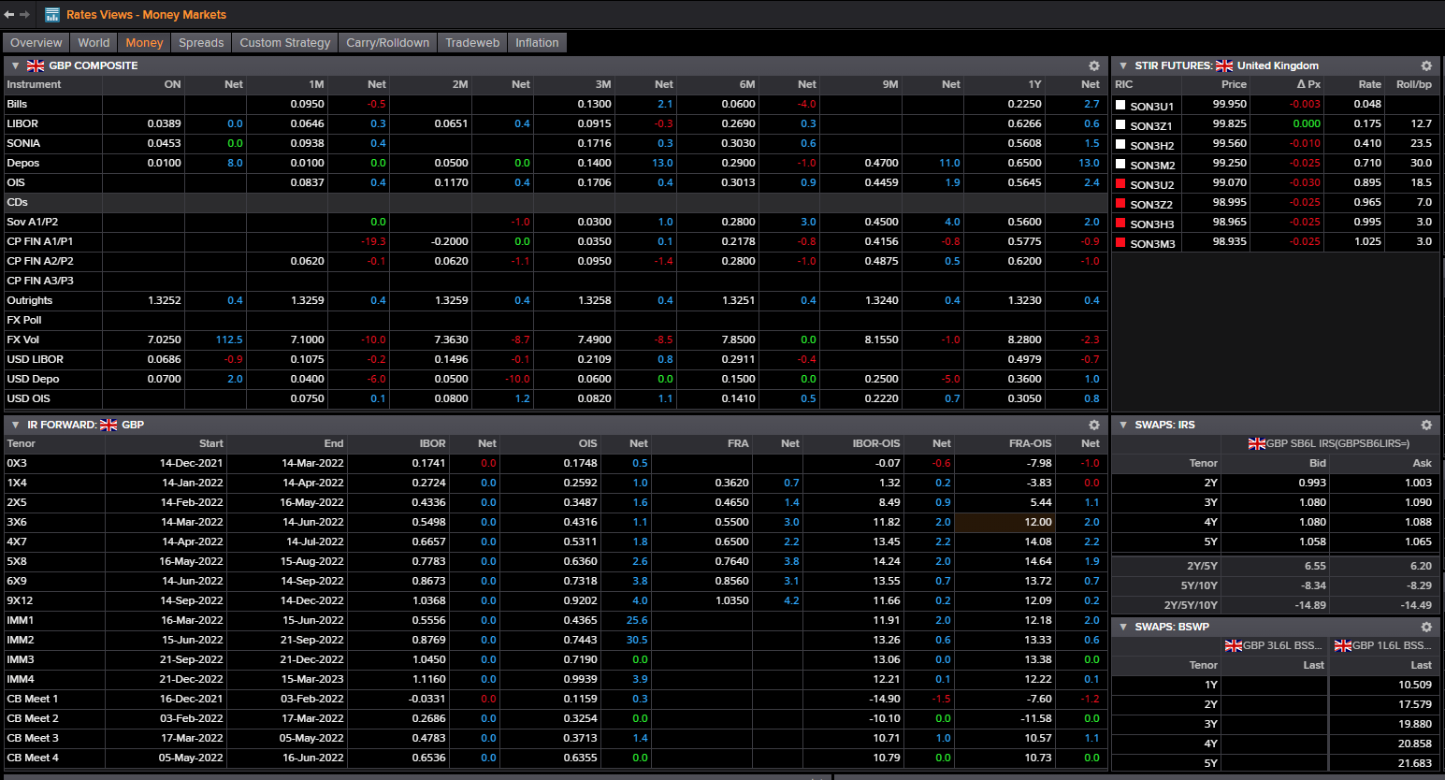
Rates Views Money
New RFRs OIS, STIR Futures, Spreads have been exposed in Rates Views Money and Overview
18
An LSEG Business

Slide 19
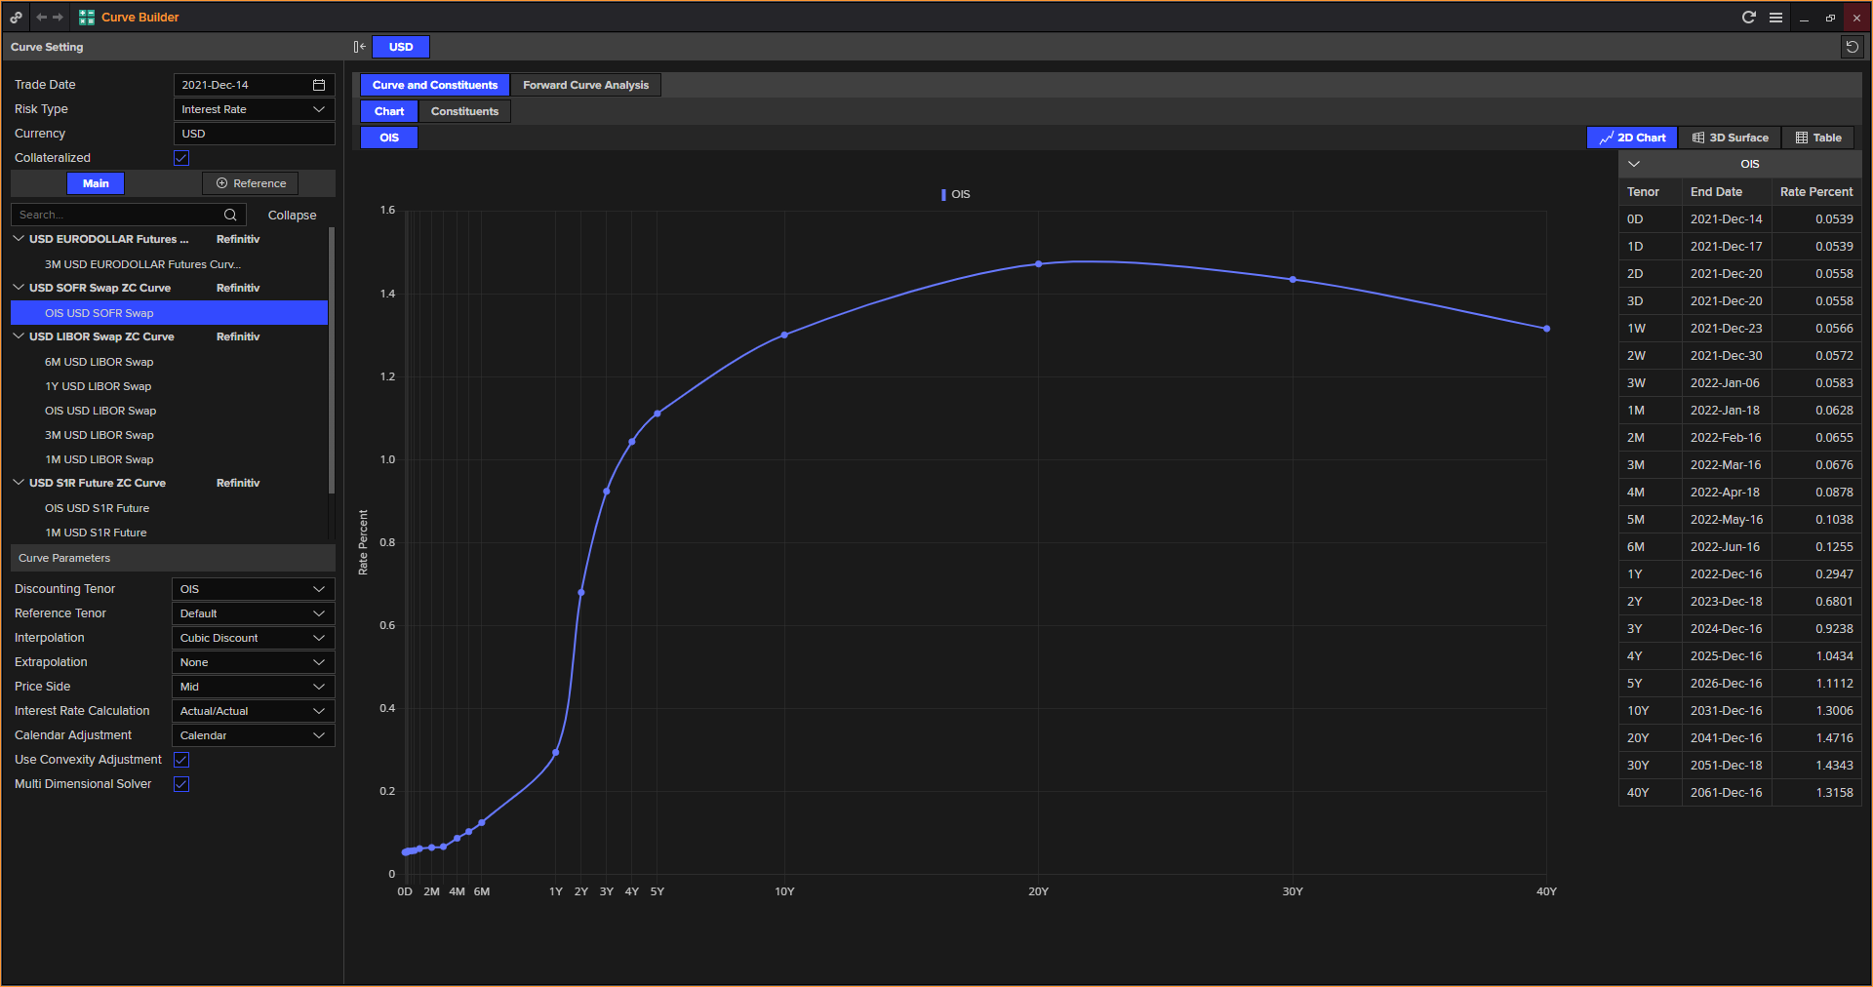
Find new RFR OIS Zero Coupon based Curves
Type “CURVB” to open the Eikon Curves App and find curves by currencies including new RFR curves
19
An LSEG Business

Slide 20
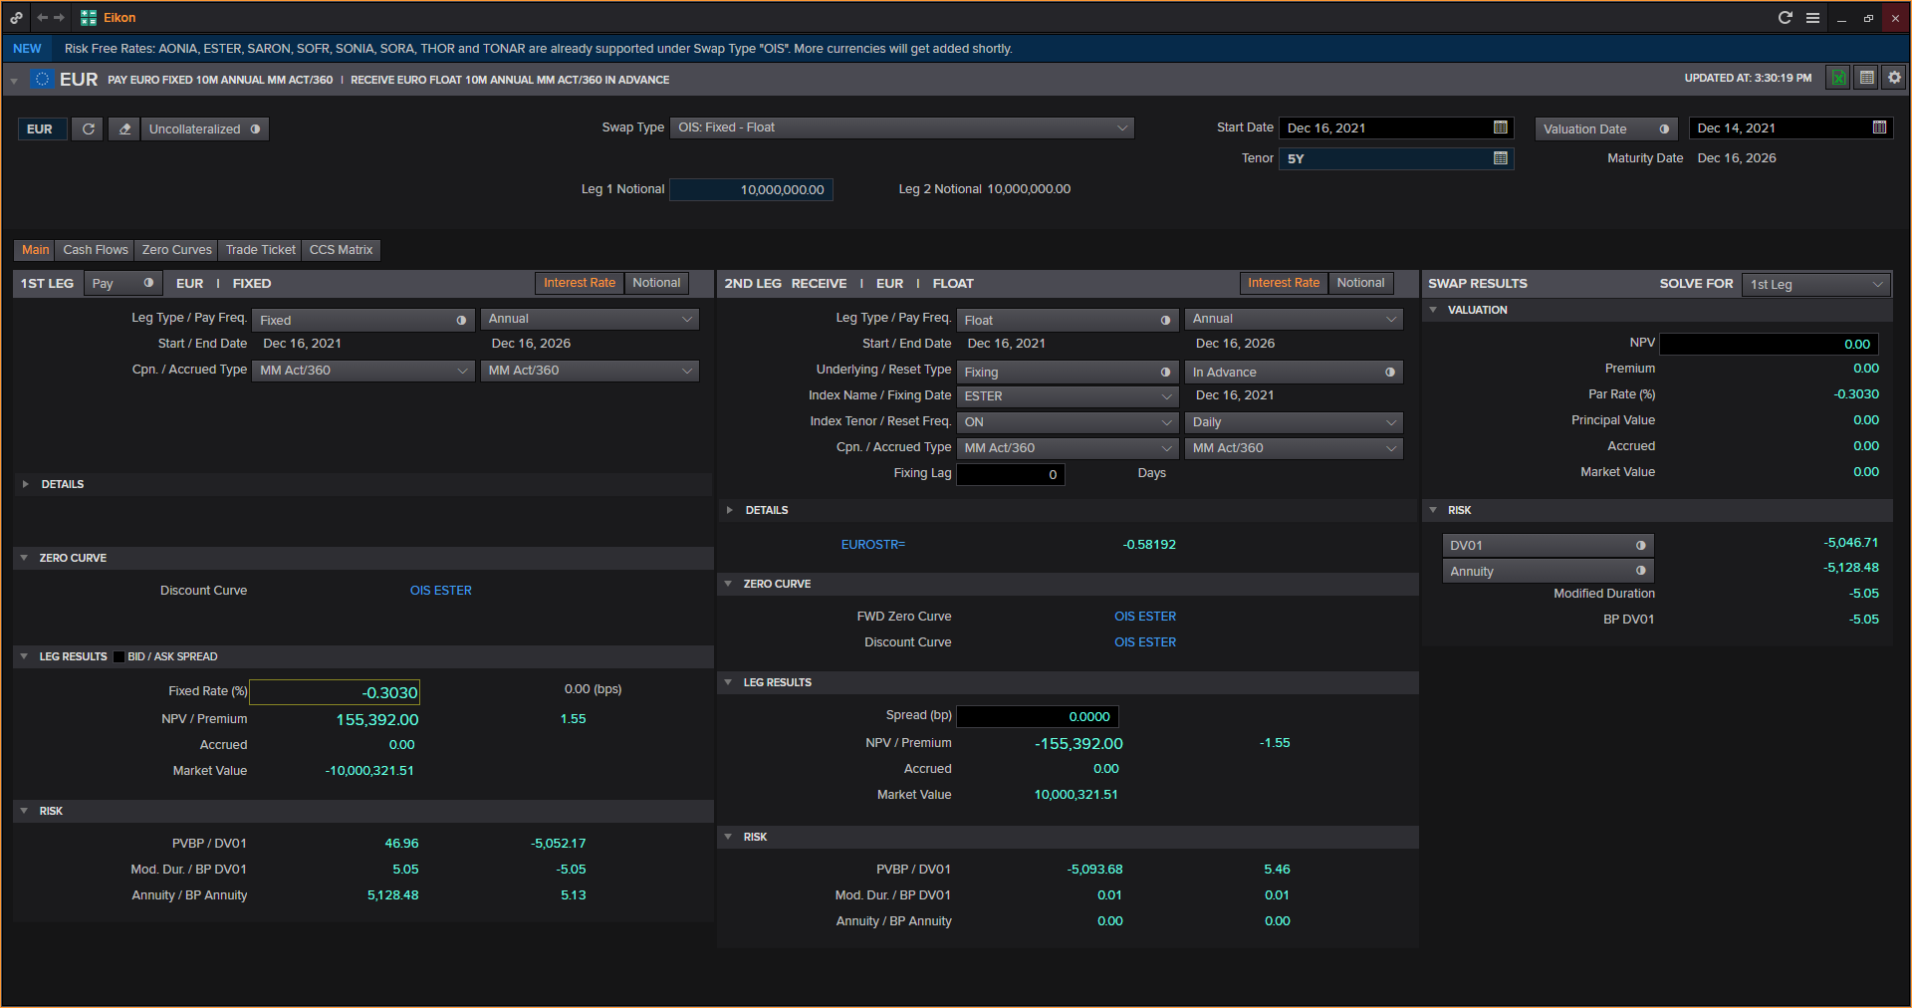
Use new RFR OIS Zero Coupon based Curves in Calculators
Type “SWPR” to open the Swap Pricer calculator
20
An LSEG Business

Slide 21
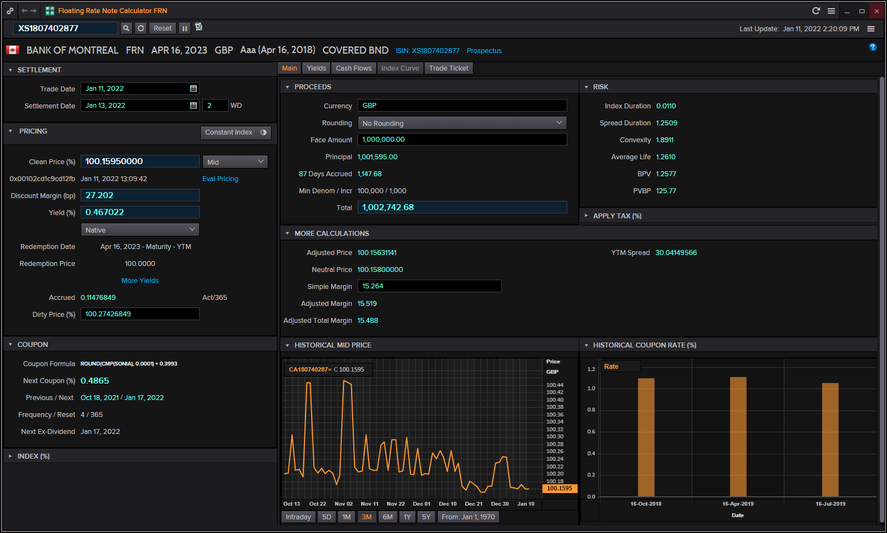
Upgraded Bond Calc to price new RFR FRNS
Type “BNDC” to open the Bond calculator and enter an ISIN
21
An LSEG Business

Slide 22
Bond Views, Index Transition Details
22
An LSEG Business

Slide 23
Key Eikon App shortcuts
IBOR IBOR App SRCH Search tools home page OTCP OTC Pricer CURVB Curve Builder BNDFOSRCH Future Search tool GOVSRCH Bond Search tool CURVESRCH Curve Search tool IRDOTCSRCH Rates Derivatives Search tool FINIM New Issue Monitor App BNDC Bond Calculator SWPR Swap Pricer Calculator

Slide 24
Appendix

Slide 25
Links and resources
Refinitiv LIBOR Transition & Replacement Rate solutions website Last Days of LIBOR by Refinitiv and Waters Technology Navigating the LIBOR transition – white paper Refinitiv Term SONIA Refinitiv USD IBOR Cash Fallbacks Tokyo Swap Rates

